Slide 1
TCP & UDP
Archisman De (Roll – 314)
Arnab Maity (Roll – 256)

Slide 2
PROCESS-TO-PROCESS DELIVERY
The transport layer is responsible for process-to-process delivery—the delivery of a packet, part of a message, from one process to another. Two processes communicate in a client/server relationship, as we will see later.

Slide 3
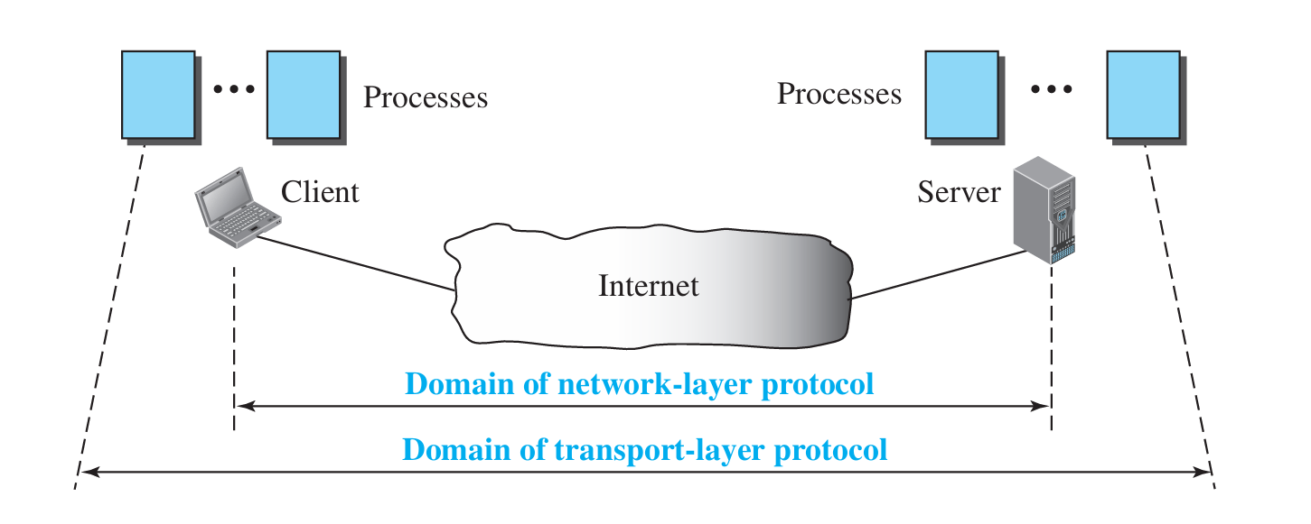
Types of data deliveries

Slide 4

Port numbers

Slide 5

IP addresses versus port numbers

Slide 6

IANA ranges
IANA – Internet Assigned Numbers Authority

Slide 7

Socket address

Slide 8
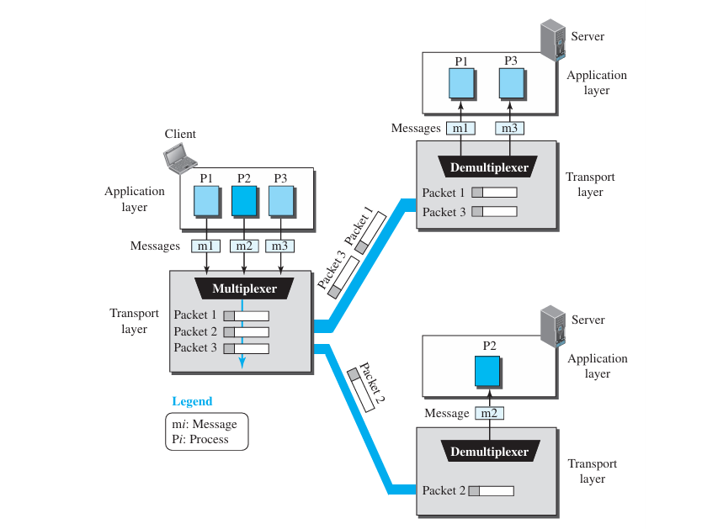
Multiplexing and demultiplexing

Slide 9

Error control

Slide 10

Position of UDP, TCP in TCP/IP suite

Slide 11
USER DATAGRAM PROTOCOL (UDP)
The User Datagram Protocol (UDP) is called a connectionless, unreliable transport protocol. It does not add anything to the services of IP except to provide process-to-process communication instead of host-to-host communication.

Slide 12


Well-known ports used with UDP

Slide 13
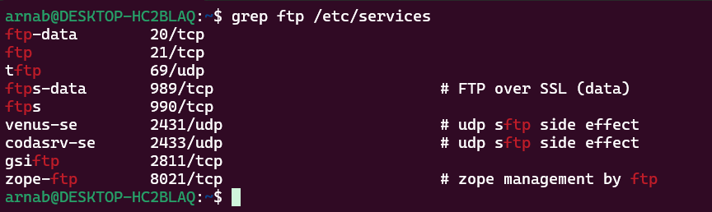
Example
In UNIX, the well-known ports are stored in a file called /etc/services. Each line in this file gives the name of the server and the well-known port number. We can use the grep utility to extract the line corresponding to the desired application. The following shows the port for FTP. Note that FTP can use port 21 with either UDP or TCP.

Slide 14
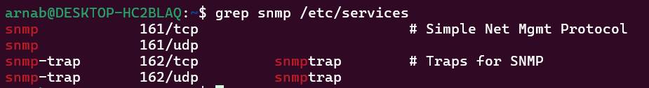
Example (continued)
SNMP uses two port numbers (161 and 162), each for a different purpose

Slide 15

Figure 1 User datagram format
Note: UDP length = IP length – IP header’s length

Slide 16

Figure 2 Pseudoheader for checksum calculation

Slide 17
Example
Figure 3 shows the checksum calculation for a very small user datagram with only 7 bytes of data. Because the number of bytes of data is odd, padding is added for checksum calculation. The pseudoheader as well as the padding will be dropped when the user datagram is delivered to IP.

Slide 18

Figure 3: Checksum calculation of a simple UDP user datagram

Slide 19

Figure 4 Queues in UDP

Slide 20
TCP
TCP is a connection-oriented protocol; it creates a virtual connection between two TCPs to send data. In addition, TCP uses flow and error control mechanisms at the transport level.

Slide 21

Table Well-known ports used by TCP

Slide 22

Figure 5 Stream delivery

Slide 23

Figure 6 Sending and receiving buffers

Slide 24

Figure 7 TCP segments

Slide 25
Note: The bytes of data being transferred in each connection are numbered by TCP.
The numbering starts with a randomly generated number.

Slide 26

Example
The following shows the sequence number for each segment:

Slide 27
Note:
The value in the sequence number field of a segment defines the number of the first data byte contained in that segment.
The value of the acknowledgment field in a segment defines the number of the next byte a party expects to receive. The acknowledgment number is cumulative.

Slide 28

Figure 8 TCP segment format

Slide 29

Figure 9 Control field

Slide 30

Table Description of flags in the control field

Slide 31

Figure 10 Connection establishment using three-way handshaking

Slide 32
Note:
A SYN segment cannot carry data, but it consumes one sequence number.
A SYN + ACK segment cannot carry data, but does consume one sequence number.
An ACK segment, if carrying no data, consumes no sequence number.

Slide 33

Figure 11 Data transfer

Slide 34

Figure 12 Connection termination using three-way handshaking

Slide 35
Note:
The FIN segment consumes one sequence number if it does not carry data.
The FIN + ACK segment consumes one sequence number if it does not carry data.

Slide 36

Figure 13 Half-close

Slide 37

Figure 14 Sliding window

Slide 38
Note:
A sliding window is used to make transmission more efficient as well as
to control the flow of data so that the destination does not become
overwhelmed with data.
TCP sliding windows are byte-oriented.

Slide 39
Example
What is the value of the receiver window (rwnd) for host A if the receiver, host B, has a buffer size of 5000 bytes and 1000 bytes of received and unprocessed data?
Solution
The value of rwnd = 5000 − 1000 = 4000. Host B can receive only 4000 bytes of data before overflowing its buffer. Host B advertises this value in its next segment to A.

Slide 40

Example

Slide 41
Some points about TCP sliding windows:
The size of the window is the lesser of rwnd and cwnd.
The source does not have to send a full window’s worth of data.
The window can be opened or closed by the receiver, but should not be shrunk.
The destination can send an acknowledgment at any time as long as it does not result in a shrinking window.
The receiver can temporarily shut down the window; the sender, however, can always send a segment of 1 byte after the window is shut down.

Slide 42

Figure 15 Normal operation

Slide 43

Figure 16 Lost segment

Slide 44

Figure 17 Fast retransmission

Slide 45


